Slide 1

Introduction to RDBMS & Oracle SQL

Slide 2
Table of Content
Module | Topic
Module 1: | DBMS & RDBMS Concepts
Module 2: | Building a Logical Database Model (E-R diagrams)
Module 3: | Database Normalization
Module 4: | Getting Started with Oracle
Module 5: | Data Retrieval and Ordering the Output
Module 6: | Creating Table Structures
Module 7: | Inserting, Modifying and Deleting Data
Module 8: | Modifying Table Structure
Module 9: | Integrity Constraints
Module 10: | Built-in Functions
Module 11: | Joins & Sub Queries

Slide 3
Module 1: DBMS & RDBMS Concepts
Overview
File System
Disadvantage of File System
Database Management System (DBMS)
Instances and Schemas
Data Models
DML & DDL
Introduction to RDBMS
Relationship
Keys

Slide 4
File System
Flat Files is a file of data that does not contain links to other files or is a non-relational database
Example
Bob |123 street | California | $200.00 Nathan | 800 Street | Utah | $10.00

Slide 5
Disadvantage of File System
In the early days, database applications were built directly on top of file systems
Drawbacks of using file systems to store data:
Potential duplication
Non-unique records
Harder to update
Inherently inefficient
Harder to change data format
Poor at complex queries
Security issues
Notes:
Potential duplication. As more and more records are added to the database it becomes difficult to avoid duplicate records. This is because there is no mechanism built in to the system to prevent duplication. Later you will see how 'primary keys' are used to prevent this.
Non-unique records. Notice that Mr & Mrs Jones have identical ID's. This is because the person producing this database decided they may want to sort on identical telephone numbers and so has applied identical ID to the two records. This is fine for that purpose, but suppose you only wanted to extract Mrs Jones' record. Now it is much more difficult.
Harder to update. Suppose that this flat file database also stored their work place details - this will result in multiple records for each person. Again, this is fine - but suppose Sandra Jones now wanted to be known as 'Sandra Thompson' after re-marrying? This will have to be done over potentially many records and so flat file updates are more error-prone than other methods
Inherently inefficient. Consider a situation where the database now needs to hold an extra field to hold their email address. If there are tens of thousands of records, there may be many people having no email address, but each record in a flat file database has to have the same fields, whether they are used or not. Other methods avoid this wasted storage.
Harder to change data format. Suppose the telephone numbers now have to have a dash between the area code and the rest of the number, like this 0223-44033. Adding that extra dash over tens of thousands of records would be a significant task in a flat file database.
Poor at complex queries. If we wanted to find all records with a specific telephone number, this is a simple single-field criteria that a flat file can easily deal with. But now suppose we wanted all people living in Hull who share the same surname and similar postcode? - the criteria can quickly become too complex for a flat file to manage.
Poor at limiting access. Suppose this flat file database held a confidential field in each record that only certain staff are allowed to see - perhaps salaries. This is difficult to achieve in a flat file database - once a person has entered a valid password to gain access, that person is able to see everything.

Slide 6
Database Management System (DBMS)
DBMS contains information about a particular enterprise
Collection of interrelated data
Set of programs to access the data
An environment that is both convenient and efficient to use
Database Applications:
Banking: all transactions
Airlines: reservations, schedules
Universities: registration, grades
Sales: customers, products, purchases
Online retailers: order tracking, customized recommendations
Manufacturing: production, inventory, orders, supply chain
Human resources: employee records, salaries, tax deductions
Databases touch all aspects of our lives

Slide 7
DBMS Level of Abstraction
Physical level: describes how a record (e.g., customer) is stored.
Logical level: describes data stored in database, and the relationships among the data.
type customer = record
customer_id : string; customer_name : string; customer_street : string; customer_city : string;
end;
View level: application programs hide details of data types. Views can also hide information (such as an employee’s salary) for security purposes.

Slide 8
View of Data
An Architecture for a database system
View Level
View 1
View 2
….
View n
Logical View
Physical View

Slide 9
Instances and Schemas
Schema – the logical structure of the database
Example: The database consists of information about a set of customers and accounts and the relationship between them)
Instance – the actual content of the database at a particular point in time

Slide 10
Data Models
A model is a representation of reality, ‘real world’ objects and events, and their associations. It is an abstraction that concentrates on the essential, inherent aspects of an organization and ignore the accidental properties.
The purpose of a data model is to represent data and to make the data understandable.

Slide 11
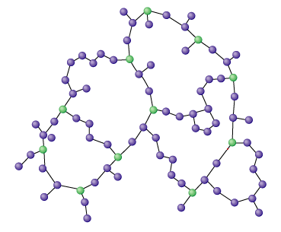
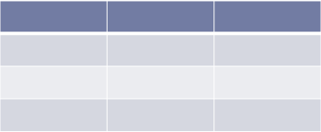
Data Models Continue…
Data Models are categorized into three Types
Hierarchical Model
Network Model
Relational Model
Notes:
The importance aspect of database approach is to hide the details of data storage not needed by the many of the database users.
This goal is achieved by the concept of Data Models.
Hierarchical Model : The hierarchical data model organizes data in a tree structure. There is a hierarchy of parent and child data segments. This structure implies that a record can have repeating information, generally in the child data segments.
Network Model : Some data was more naturally modeled with more than one parent per child. So, the concept called network model permitted the modeling of many-to-many relationships in data.
Relational Model :In such a database the data and relations between them are organised in tables. A table is a collection of records and each record in a table contains the same fields.

Slide 12
Data Manipulation Language (DML)
Language for accessing and manipulating the data organized by the appropriate data model
DML also known as query language
Two classes of languages
Procedural – user specifies what data is required and how to get those data
Declarative (nonprocedural) – user specifies what data is required without specifying how to get those data
SQL is the most widely used query language

Slide 13

Data Definition Language (DDL)
CREATE TABLE DEPT
(
DEPTNO NUMERIC(2),
DNAME VARCHAR(14),
LOC VARCHAR(13)
)
Specification notation for defining the database schema
Example:
DDL compiler generates a set of tables stored in a data dictionary
Data dictionary contains metadata (i.e., data about data)
Database schema
Data storage and definition language
Specifies the storage structure and access methods used
Integrity constraints
Domain constraints
Referential integrity (e.g. branch_name must correspond to a valid branch in the branch table)
Authorization

Slide 14
Introduction to RDBMS
RDBMS stands for Relational Database Management System
A DBMS in which data is stored in tables and the relationships among the data are also stored in tables.
A Relational database management system (RDBMS) is a database management system (DBMS) that is based on the relational model as introduced by E. F. Codd.

Slide 15
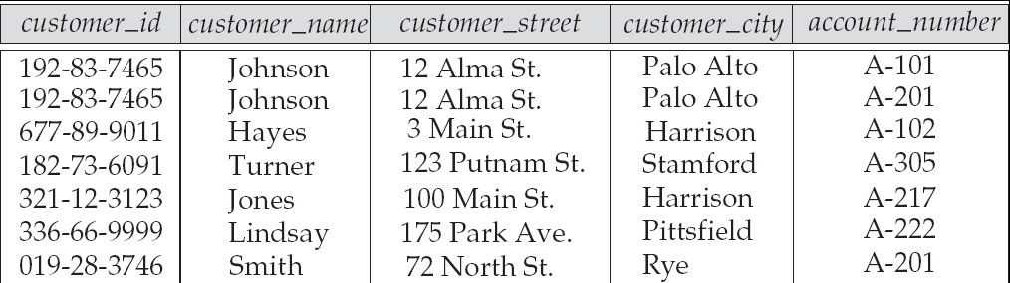
Relational Database Model
Attribute
Tuple

Slide 16
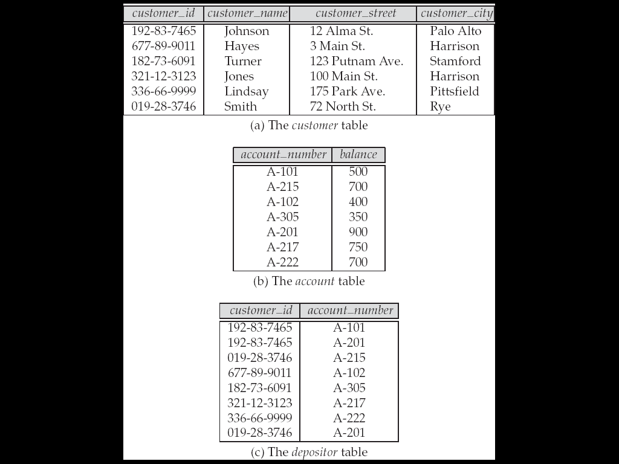
Sample Relational Database

Slide 17
Relationship
EmpCode | EmpName | Address | Salary | Deptno
E001 | Rajendra | Mumbai | 20000 | 10
E002 | Rupesh | Mumbai | 15000 | 10
E003 | Vandana | Pune | 25000 | 30
E004 | Anju | Chennai | 22000 | 20
E005 | Ajay | Pune | 35000 | 30
Deptno | Dname | Location
10 | Admin | Mumbai
20 | IT | Pune
30 | Sales | Chennai
A relationship is an association between two or more tables.

Slide 18
Keys
Keys are fundamental part of relational database because they enable tables in the database to be related with each other.
Types of keys are:
Primary Key
Primary key is a key that uniquely identify each record in a table. It cannot be NULL.
Composite Key
Key that consist of two or more columns that uniquely identify an entity occurrence is called Composite key.
Foreign Key
A foreign key is column or set of columns in a table whose values match a primary key in another table.

Slide 19
Keys continue…
Candidate Key
Candidate keys are defined as the set of fields from which primary key can be selected.
Alternate Key
The candidate keys that are not selected as primary key are known as alternate keys.
Super Key
Super key is a column or combination of columns that identifies a record within the table.

Slide 20
Keys continue…
Id | F_Name | L_Name | Phone | Email | Salary | Address_id
101 | John | Obama | 11111 | a@a.in | 10000 | 505
102 | Tom | Bush | 22222 | b@a.in | 20000 | 302
103 | Ivan | Kerry | 33333 | c@a.in | 30000 | 211
Primary Key: {Id}
Composite Key: {Id, companyId}
Foreign Key: {Address_id}
Candidate Key: {Id}, {F_Name,L_Name}, {Phone}, {Email}
Alternate Key: {F_Name, L_Name}, {Phone}, {Email}
Super Key: {Id}, {F_Name, L_Name}, {Phone}, {Email}, {Id, Salary}, {Id, Phone}, {Id, Email}, {Phone, Email}

Slide 21
Module 2: Building a Logical Database
Overview
Database Design
Modeling Methodology
Introduction to E-R Diagram
Entity
Attribute
Tuple
Chain Notation
Relationship degree
Relationship Participation
Integrity Constraints

Slide 22
Database Design
To design database following are the steps:
Requirement Analysis
Diagrammatic representation
Translating Diagrams to tables
Refining the tables based on fixed set of rules.

Slide 23
Data Modeling
Data modeling in software engineering is the process of creating a data model for an information system by applying formal data modeling techniques.
The goal of the data model is to make sure that the all data objects required by the database are completely and accurately represented.

Slide 24
Modeling Methodology
Data models represent information areas of interest. While there are many ways to create data models:
Bottom-up models or View Integration models
The methodology is often the result of reengineering effort.
Top-down logical data models
This methodology on other hand, are created in an abstract way by getting information from people.
Notes:
The top-down method starts from the general and moves to the specific. Basically, you start with a general idea of what is needed for the system and then ask the end-users what data they need to store. For example: automobile manufacturer industry must get requirements of car price, average, dimensions.. So they should follow top-down approach.
The bottom-up approach begins with the specific details and moves up to the general. To begin a bottom-up design, the system analyst will inspect all the interfaces that the system has, checking reports, screens, and forms. The analyst will work backwards through the system to determine what data should be stored in the database. For example, Exit poll results follow bottom-up approach.

Slide 25
Entity relationship diagrams
An entity-relationship model (ERM) is an abstract conceptual representation of structured data.
Entity-relationship modeling is a relational schema database modeling method, used in software engineering to produce a type of conceptual data model (or semantic data model) of a system, often a relational database, and its requirements in a top-down fashion.

Slide 26
Entity
In relation to a database , an entity is a single person, place, or thing about which data can be stored.
In data modeling (a first step in the creation of a database), an entity is some unit of data that can be classified and have stated relationships to other entities.
Example
Employee

Slide 27
Attributes
Characteristics/properties of an entity, that provide descriptive details of it.
every attribute must be given a name that is unique across the entity.
Attributes are represented by ovals and are connected to the entity with a line.
empId
empName
Employee

Slide 28
Chain Notation Attribute
Types of Attribute
Simple Attribute
empName
Primary Key
empID
Multi-Valued
EmpAddress
ID
Composite
enquieryID
Month
year

Slide 29
Relationship Degree
Relationship degree indicates the number of entities involved in the relationship
Binary Relation
Ternary Relation
Unary Relation
Employee
Employee
Employee
Works
Project
Works
Reporting Manager
Department
Skill

Slide 30
Relationships among Tables
A database consisting of independent and unrelated tables serves little purpose. The power of relational database lies in the relationship that can be defined between tables.
The types of relationship include
One-to-one
One-to-many
Many-to-many

Slide 31
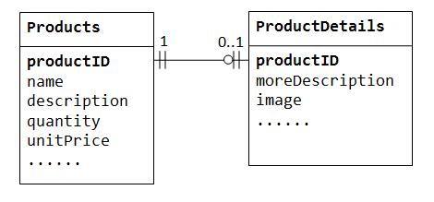
One to One
Notes:
One-to-One
In a "product sales" database, a product may have optional supplementary information such as image, moreDescription and comment. Keeping them inside the Products table results in many empty spaces (in those records without these optional data). Furthermore, these large data may degrade the performance of the database.
Instead, we can create another table (says ProductDetails, ProductLines or ProductExtras) to store the optional data. A record will only be created for those products with optional data. The two tables, Products and ProductDetails, exhibit a one-to-one relationship. That is, for every row in the parent table, there is at most one row (possibly zero) in the child table. The same columnproductID should be used as the primary key for both tables.

Slide 32
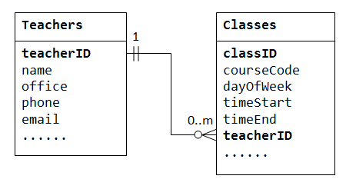
One to Many
Notes:
One-to-Many
In a "class roster" database, a teacher may teach zero or more classes, while a class is taught by one (and only one) teacher. In a "company" database, a manager manages zero or more employees, while an employee is managed by one (and only one) manager. In a "product sales" database, a customer may place many orders; while an order is placed by one particular customer. This kind of relationship is known as one-to-many.
One-to-many relationship cannot be represented in a single table. For example, in a "class roster" database, we may begin with a table called Teachers, which stores information about teachers (such as name, office, phone and email). To store the classes taught by each teacher, we could create columns class1, class2, class3, but faces a problem immediately on how many columns to create. On the other hand, if we begin with a table called Classes, which stores information about a class (courseCode, dayOfWeek, timeStart and timeEnd); we could create additional columns to store information about the (one) teacher (such as name, office, phone and email). However, since a teacher may teach many classes, its data would be duplicated in many rows in table Classes.

Slide 33
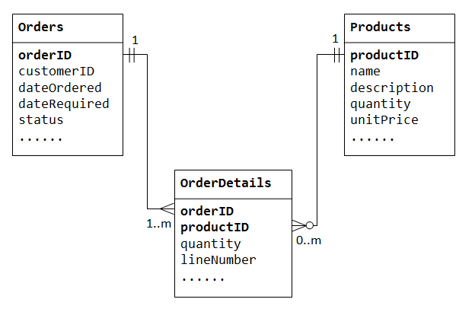
Many to Many
Notes:
Many-to-Many
In a "product sales" database, a customer's order may contain one or more products; and a product can appear in many orders. In a "bookstore" database, a book is written by one or more authors; while an author may write zero or more books. This kind of relationship is known as many-to-many.
Let's illustrate with a "product sales" database. We begin with two tables: Products and Orders. The table products contains information about the products (such as name, description andquantityInStock) with productID as its primary key. The table orders contains customer's orders (customerID, dateOrdered, dateRequired and status). Again, we cannot store the items ordered inside the Orders table, as we do not know how many columns to reserve for the items. We also cannot store the order information in the Products table.

Slide 34
Relationship Participation
Fundamental/Strong entity
an entity that is capable of its own existence - i.e. an entity whose instances exist not with standing the existence of other entities.
Weak Entities
an entity that is not capable of its own existence.
Associative Entities
Associative entity is an entity that is used to resolve a many: many relationship.
Notes:
Strong entity: For example Employee can exist without associated with any department.
Weak entity: For example OrderItem because OrderItem has no meaning without having any order associated.
Associative entity: For example Registration because relationship between student & course is N:N.

Slide 35
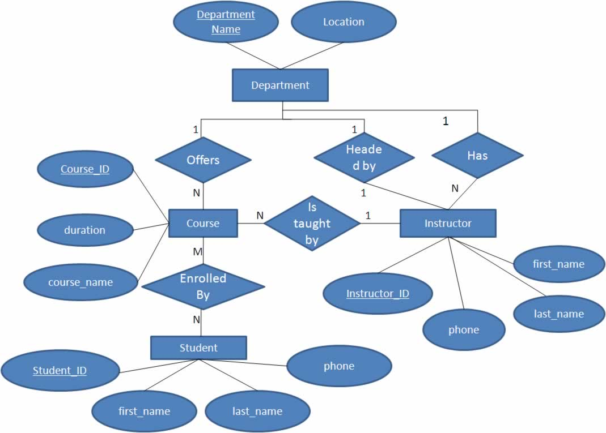
E-R Diagram Example

Slide 36
Bank ERD exercise
The person opens an Account in a Bank and gets a account number and ATM card. The person can make transactions in ATM centers.

Slide 37
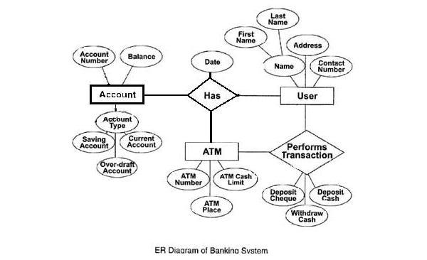
Bank ERD
Notes:
Refer http://cssimplified.com/assignments/construct-an-er-diagram-for-a-banking-system-clearly-indicate-the-entities-relationships-cardinality-and-the-key-constraints-also-derive-the-un-normalized-relational-database-tables-with-the-help

Slide 38
Company ERD exercise
A company has several departments. Each department has a supervisor and at least one employee. Employees must be assigned to at least one, but possibly more departments. At least one employee is assigned to a project, but an employee may be on vacation and not assigned to any projects. The important data fields are the names of the departments, projects, supervisors and employees, as well as the supervisor and employee number and a unique project number.
Note:
1) Supervisor is not an employee.
2) One employee can work on many projects.

Slide 39
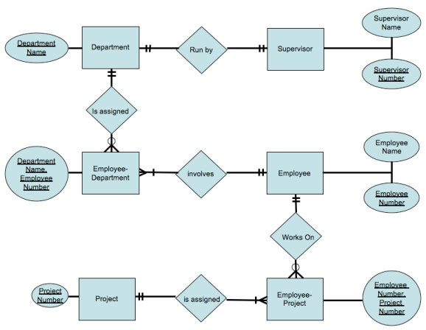
Company ERD
Notes:
Refer: http://www.javaguicodexample.com/erddatabasemodelnotes.pdf

Slide 40
Integrity Constraints
Integrity means something like 'be right' and consistent. The data in a database must be right and in good condition.
Domain Integrity
Entity Integrity Constraint
Referential Integrity Constraint
Foreign Key Integrity Constraint

Slide 41
Domain Integrity
Domain integrity means the definition of a valid set of values for an attribute. You define
data type,
length or size
is null value allowed
is the value unique or not
for an attribute.
You may also define the default value, the range (values in between) and/or specific values for the attribute.

Slide 42
Integrity Constraints continue…
Entity Integrity Constraint
The entity integrity constraint states that primary keys can't be null. There must be a proper value in the primary key field.
Referential Integrity Constraint
The referential integrity constraint is specified between two tables and it is used to maintain the consistency among rows between the two tables.
Foreign Key Integrity Constraint
There are two foreign key integrity constraints: cascade update related fields and cascade delete related rows.

Slide 43
Module 3: Database Normalization
Overview
Introduction to Normalization
Normalization Rule

Slide 44
Introduction to Normalization
Database Normalization is a technique of organizing the data in the database. Normalization is a systematic approach of decomposing tables to eliminate data redundancy and undesirable characteristics like Insertion, Update and Deletion.

Slide 45
Why Normalization?
Database without normalization face the following deviation from standards also called anomalies:
Insert anomaly
Update anomaly
Delete anomaly
Take an example of following PRODUCT table:
Id | Product_name | Product_cost | Product_location
1001 | Solar Cooker | 3000 | Pune
1002 | Solar AC | 25000 | Mumbai
1003 | Solar Lamp | 2000 | Kolkata
1004 | Solar Cooker | 3000 | Indore

Slide 46
Why Normalization continued…
Insert anomaly:
Insert Anomaly occurs when certain attributes cannot be inserted into the database without the presence of other attributes. For example we cannot insert new product information into PRODUCT table unless we know the location where we wish to launch it.
Update anomaly:
Update Anomaly exists when one or more instances of duplicated data is updated, but not all. Suppose we want to update the price of ‘Solar Cooker’ in PRODUCT table.

Slide 47
Why Normalization continued…
Delete anomaly:
Delete Anomaly exists when certain attributes are lost because of the deletion of other attributes. Suppose we want to delete ‘Mumbai’ manufacturing location then information about ‘Solar AC’ will also be lost.
Thus, in order to overcome the anomalies, we need database normalization.

Slide 48
Normalization Rule
Normalization rule are divided into following normal form.
First Normal Form (1NF)
Second Normal Form (2NF)
Third Normal Form (3NF)

Slide 49
First Normal Form (1NF) continued…
Table will be in 1st normal form if
There are no duplicated rows in the table.
Each cell is single-valued (i.e., there are no repeating groups or arrays).
Entries in a column (attribute, field) are of the same kind.

Slide 50
First Normal Form (1NF) continued…
Consider the following table:
College | Student | Age | Subject
Fergusson | Adam | 15 | Biology, Maths
MIT | Alex | 14 | Maths
BMCC | Stuart | 17 | Maths

Slide 51
First Normal Form (1NF) continued…
Table after 1st Normal Form:
College | Student | Age
Fergusson | Adam | 15
MIT | Alex | 14
BMCC | Stuart | 17
College | Student | Subject
Fergusson | Adam | Biology
Fergusson | Adam | Maths
MIT | Alex | Maths
BMCC | Stuart | Maths

Slide 52
Second Normal Form (2NF)
Table should be in 1st Normal Form
As per the 2NF there must not be any partial dependency of any column on primary key
It means that for a table that has concatenated primary key, each column in the table that is not part of the primary key must depend upon the entire concatenated key for its existence. If any column depends only on one part of the concatenated key, then the table fails Second normal form.

Slide 53
Second Normal Form (2NF) Continue…
Composite
Primary Key
Column should dependent on Primary Key
College | Student | Age
Fergusson | Adam | 15
Fergusson | Adam | 15
MIT | Alex | 14
BMCC | Stuart | 17
Student Table in 1st Normal Form
Notes:
In example of First Normal Form there are two rows for Adam, to include multiple subjects that he has opted for. While this is searchable, and follows First normal form, it is an inefficient use of space. Also in the above Table in First Normal Form, while the candidate key is {College, Student}, Age of Student only depends on Student column, which is incorrect as per Second Normal Form. To achieve second normal form, it would be helpful to split out the subjects into an independent table, and match them up using the student names as foreign keys.

Slide 54
Second Normal Form (2NF) Continue…
Part of Composite Key
Depending column
College | Student | Age
Fergusson | Adam | 15
Fergusson | Adam | 15
MIT | Alex | 14
BMCC | Stuart | 17
Student Table in 1st Normal Form
Notes:
In example of First Normal Form there are two rows for Adam, to include multiple subjects that he has opted for. While this is searchable, and follows First normal form, it is an inefficient use of space. Also in the above Table in First Normal Form, while the candidate key is {Student, Subject}, Age of Student only depends on Student column, which is incorrect as per Second Normal Form. To achieve second normal form, it would be helpful to split out the subjects into an independent table, and match them up using the student names as foreign keys.

Slide 55
Second Normal Form (2NF) Continue…
Student Table in 1st Normal Form
College | Student | Age
Fergusson | Adam | 15
MIT | Alex | 14
BMCC | Stuart | 17
New Student Table following 2NF will be :
New Subject Table following 2NF will be :
Student | Age
Adam | 15
Alex | 14
Stuart | 17
College | Student | Subject
Fergusson | Adam | Biology
Fergusson | Adam | Maths
MIT | Alex | Maths
BMCC | Stuart | Maths
Notes:
In example of First Normal Form there are two rows for Adam, to include multiple subjects that he has opted for. While this is searchable, and follows First normal form, it is an inefficient use of space. Also in the above Table in First Normal Form, while the candidate key is {Student, Subject}, Age of Student only depends on Student column, which is incorrect as per Second Normal Form. To achieve second normal form, it would be helpful to split out the subjects into an independent table, and match them up using the {College, Student} as foreign keys.

Slide 56
Third Normal Form (3NF)
Third Normal form applies that every non-prime attribute of table must be dependent on primary key. The transitive functional dependency should be removed from the table. The table must be in Second Normal form. For example, consider a table with following fields.

Slide 57
Example
Student_Detail Table
Primary Key
Std_id | Std_name | DOB | Street | city | State | Zip
1088 | Rahul | 01-Jan-1987 | G.G. Road | Thane | MH | 400601
1092 | Kiran | 08-Aug-1989 | Karve Road | Dombivali | MH | 4210202
2010 | Amit | 19-Sep-1984 | G.G. Road | Thane | MH | 400601
2211 | Geeta | 01-Feb-2000 | Karve Road | Dombivali | MH | 4210202

Slide 58
Example
Student_Detail Table
Transitive Dependency
street, city and state depends upon Zip
Std_id | Std_name | DOB | Street | city | State | Zip
1088 | Rahul | 01-Jan-1987 | G.G. Road | Thane | MH | 400601
1092 | Kiran | 08-Aug-1989 | Karve Road | Dombivali | MH | 4210202
2010 | Amit | 19-Sep-1984 | G.G. Road | Thane | MH | 400601
2211 | Geeta | 01-Feb-2000 | Kare Road | Dombivali | MH | 4210202

Slide 59
Example
New Student_Detail Table :
Student_id | Student_name | DOB | Zip
1088 | Rahul | 01-Jan-1987 | 400601
1092 | Kiran | 08-Aug-1989 | 4210202
2010 | Amit | 19-Sep-1984 | 400601
2211 | Geeta | 01-Feb-2000 | 4210202
Zip | Street | city | State
400601 | G.G. Road | Thane | MH
4210202 | Karve Road | Dombivali | MH
Address Table :
The advantage of removing transitive dependency is
Amount of data duplication is reduced.
Data integrity achieved.

Slide 60
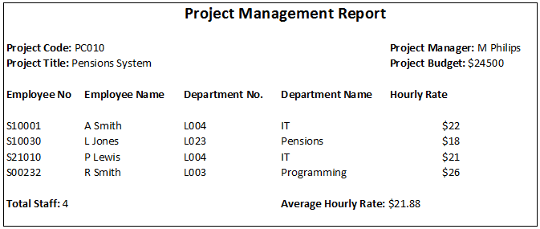
Case study

Slide 61
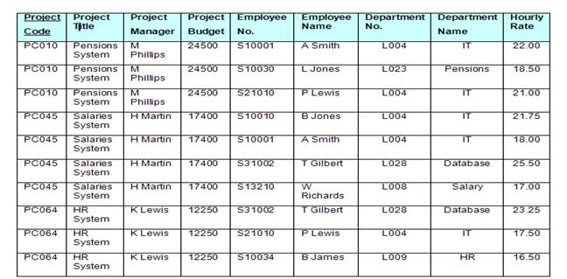
Case study continued…
Table in unnormalized form (UNF)

Slide 62
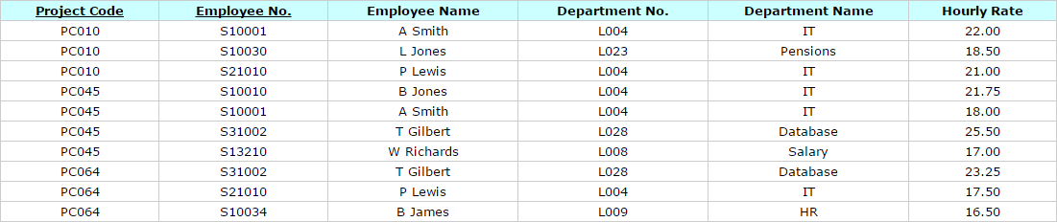
Case study continued…
Table after 1st Normal Form (1NF) Repeating Attributes Removed

Slide 63
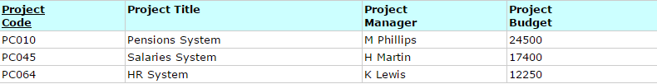
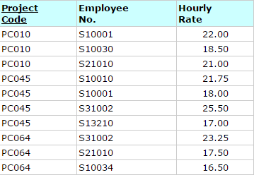
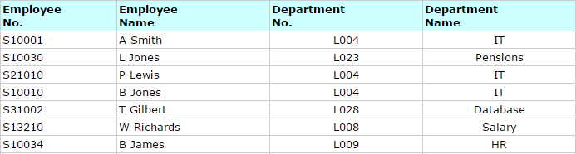
Case study continued…
Table after 2nd Normal Form (2NF) Partial Key Dependencies Removed

Slide 64
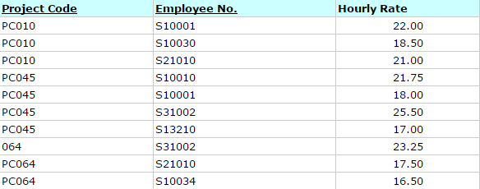
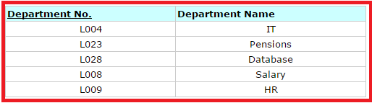
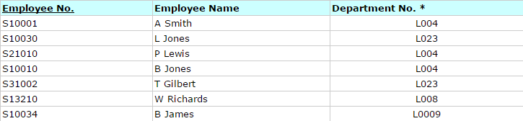
Case study continued…
Table after 3rd Normal Form (3NF) Removed transitive dependency

Slide 65
Module 4: Getting Started with Oracle
Overview
Introduction to Databases
Introducing SQL
SQL Developer with Oracle

Slide 66
Introduction to Databases
Computerized record-keeping system
EMPNO | ENAME | JOB | MANAGER | HIREDATE | SALARY | COMMISSION | DEPTNO
7369 | SMITH | CLERK | 7902 | 17-DEC-1980 | 800 |  | 20
7499 | ALLEN | SALESMAN | 7698 | 20-FEB-1981 | 1600 | 300 | 30
7521 | WARD | SALESMAN | 7698 | 22-FEB-1981 | 1250 | 500 | 30
7566 | JONES | MANAGER | 7839 | 02-APR-1981 | 2975 |  | 20
7654 | MARTIN | SALESMAN | 7698 | 28-SEP-1981 | 1250 | 1400 | 30
7698 | BLAKE | MANAGER | 7839 | 01-MAY-1981 | 2850 |  | 30
7782 | CLARK | MANAGER | 7839 | 09-JUN-1981 | 2450 | 0 | 10
7788 | SCOTT | ANALYST | 7566 | 19-APR-1987 | 3000 |  | 20
Notes:
A Database Management System is a collection of Inter-related Data and a set of program to manage and access those Data
The primary objective of a DBMS is to provide an environment that is convenient and efficient to use in retrieving data FROM and storing information into the database.
Some of the DBMS applications are Banking, Airlines, Credit Card transactions, Telecommunication, finance, sales.

Slide 67
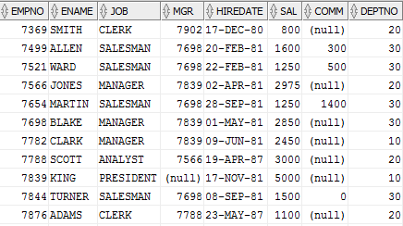
Introducing SQL
SQL statement entered
Select * from Emp
Database
Notes:
Thus SQL is a set of commands used to interact with the database, using which, sets of records can be accessed or manipulated at a time, instead of the conventional one record at a time approach.

Slide 68
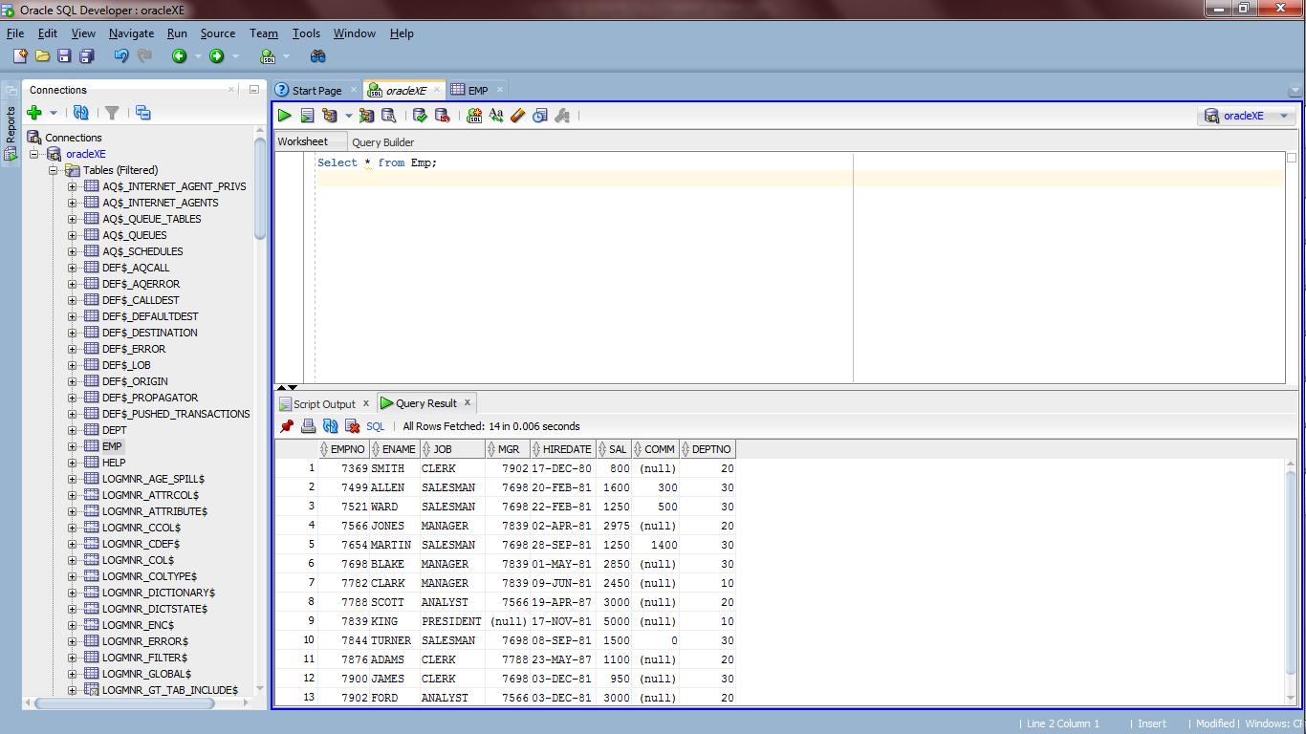
SQL Developer with Oracle

Slide 69
Module 5: Data Retrieval & Ordering Output
Overview
Simple Data Retrieval
Describing Table Structure
Conditional Retrieval using Arithmetic, Relational, Logical and Special Operators
The ORDER BY clause.
Aggregate functions
The GROUP BY and HAVING clause

Slide 70
Describing table
DESC dept
Name Null Type
--------------------------------------------------------- ---------------- ----------------------
DEPTNO NOT NULL NUMBER(2)
DNAME VARCHAR2(14)
LOC VARCHAR2(13)
BUDGET NUMBER

Slide 71
Data Retrieval
SELECT * FROM emp;
SELECT empno, ename FROM emp;
SELECT distinct deptno FROM emp;

Slide 72
Conditional Retrieval
SELECT * FROM emp WHERE sal > 3500;
SELECT empno, ename FROM emp WHERE deptno = 20;

Slide 73
Relational Operators
= equal to
!= not equal to
^= not equal to
<> not equal to
> greater than
< less than
>= greater than or equal to
<= less than or equal to
SELECT * FROM emp WHERE sal> 3000;
SELECT ename FROM emp WHERE deptno!= 10;
SELECT * FROM employee WHERE ename = ‘ALLEN’;

Slide 74
Logical Operators
The AND Operator
SELECT * FROM emp WHERE deptno = 10 AND job = ‘SALESMAN’;
SELECT * FROM emp WHERE sal >= 3000 AND sal <= 4000;
The OR Operator
SELECT * FROM emp WHERE deptno = 20 OR deptno = 10;
The NOT Operator
SELECT * FROM employee WHERE NOT deptno = 10;

Slide 75
Range & List Operators
The BETWEEN operator
SELECT * FROM emp WHERE sal BETWEEN 3000 and 4000;
SELECT * FROM emp WHERE hiredate BETWEEN '01-JAN-80' and '31-DEC-89‘
The IN operator
SELECT * FROM emp WHERE deptno IN (10,20);
SELECT * FROM emp WHERE deptno NOT IN (10,20);

Slide 76
Wildcard & is Null Operators
The LIKE operator
SELECT * FROM emp WHERE ename LIKE ‘J%';
SELECT * FROM emp WHERE ename LIKE '%AD';
SELECT * FROM emp WHERE ename LIKE '%AD%';
SELECT * FROM emp WHERE grade LIKE ‘A____';
The IS NULL operator
SELECT * FROM emp WHERE comm IS NULL;
SELECT * FROM emp WHERE comm IS NOT NULL;

Slide 77
Arithmetic Operators
+ addition
- subtraction
* multiplication
/ division
SELECT * FROM emp WHERE sal + com > 3000 and comm is not null;
SELECT ename, sal + comm FROM emp WHERE comm is not null;
SELECT ename, sal+ comm “Total Earning” FROM emp WHERE comm is not null;

Slide 78
Sorting Output
Ordering on single column
SELECT * FROM emp ORDER BY empno;
SELECT * FROM emp WHERE deptno= 10 ORDER BY ename;
SELECT * FROM emp ORDER BY sal DESC;
Ordering on multiple columns
SELECT * FROM emp ORDER BY depno, ename;
SELECT * FROM emp ORDER BY deptno, job DESC;

Slide 79
Aggregate Functions
SELECT COUNT (*) FROM emp;
SELECT SUM (sal) FROM emp;
SELECT AVG (sal) FROM emp;
SELECT MAX (sal) FROM emp;
SELECT MIN (sal) FROM emp;
SELECT * FROM employee WHERE salary = (SELECT MIN (salary) FROM employee);

Slide 80
The GROUP BY clause
SELECT deptno, sum (sal)
FROM emp
GROUP BY deptno;

Slide 81
The HAVING Clause
SELECT deptno, sum (sal) FROM emp
GROUP BY deptno
HAVING sum (sal) > 7000;
SELECT deptno, sum (sal)
FROM emp
WHERE deptno in (10, 30)
GROUP BY deptno
HAVING sum (sal) > 8000
ORDER BY sum (sal) desc;

Slide 82
Module 6: Creating Tables
Overview
Creating a Table
Data Types

Slide 83
Creating Tables
CREATE TABLE tablename (
column-name data-type [other clauses]... );
CREATE TABLE dept (
deptno varchar2 (4),
dname varchar2 (20),
loc varchar2(20)
);

Slide 84
Data Types
Data Type | Description | Example
char (n) | Fixed-length character data. Max 2000 bytes | deptno char (4)
varchar (n) | Variable-length character data. Max 4000 bytes | deptno varchar2 (4)
varchar2 (n) | Variable-length character data. Max size is 4000 bytes | deptno varchar (4)
number (p, s) | Numeric data, ‘p’ is the total length and “s” is the number of decimal places. | reading number (5, 2). Maximum value: 99.99
Date | Date and time. Range is 01/01/4712 BC to 31/12/4712 AD. | hiredate date
Notes:
Data Types
The given data types in the above slide are available for columns in a table.

Slide 85
Data Types
Data Type | Description | Example
long | Variable-length character data. Max 2 GB | remarks long
raw (n) | Binary format data. Max size 2000 bytes | esc_seqraw (15)
Long raw | Same as raw, but maximum size is 2 GB. | picture long raw
BLOB | Stores binary large objects up to 4GB
CLOB | Stores character large objects up to 4GB.
BFILE | Enables access to binary file LOBs that are stored in the file system outside the Oracle database. Maximum file size up to 4GB.

Slide 86
Module 7: Inserting, Modifying & Deleting Data
Overview
Inserting Data into a Table
Inserting Data into a Table using Sub query
Modifying Data in a Table
Deleting Data from a Table

Slide 87
Inserting Data into a Table
desc dept;
Name Null? Type
------------- --------------------- ------------------
DEPTNO NOT NULL VARCHAR2(4)
DNAME NOT NULL VARCHAR2(20)
LOC NOT NULL VARCHAR2(20)
INSERT INTO table-name VALUES (value1, value2, ...);
INSERT INTO DEPT VALUES (10,'ACCOUNTING','NEW YORK');
INSERT INTO DEPT VALUES (20,'RESEARCH','DALLAS');
INSERT INTO DEPT VALUES (30,'SALES','CHICAGO');
INSERT INTO DEPT VALUES (40,'OPERATIONS','BOSTON');

Slide 88
Customized Insertion
INSERT INTO emp (empno, sal, ename) VALUES(1051, 5000, 'Sunil');
INSERT INTO RESEARCH_EMP
SELECT * FROM employee WHERE deptno=20;
Create table RESEARCH_EMP
As
SELECT * FROM employee WHERE deptno=20;
Notes:
E

Slide 89
Modifying and Deleting Data
UPDATE emp SET sal = sal + 100;
UPDATE emp SET sal = sal + 200 WHERE deptno= 10;
DELETE FROM emp;
DELETE FROM emp WHERE deptno = 30;

Slide 90
Module 8: Modifying Table Structure
Overview
Altering Table structure
Dropping Column from a Table
Dropping a Table

Slide 91
Modifying a Table Structure
ALTER table emp
ADD (age number (2));
ALTER table emp
MODIFY (age number (3));
ALTER table emp DROP column age;
ALTER table employee DROP (comm, age);

Slide 92
Dropping a Table
DROP TABLE table-name;
DROP table dept;

Slide 93
Module 9: Integrity Constraints
Overview
Understanding Table and Column Constraints
Creating, Modifying and Dropping Column level constraints
Creating, Modifying and Dropping Table level constraints
Adding Constraints to Columns of an existing table
Enabling and Disabling Constraints
Dropping Columns and Tables having constraints
Creating, modifying & Dropping Sequence

Slide 94
Integrity Constraints
Not Null
Unique
Primary Key
Check
Foreign Key
Notes:
Integrity Constraints
Constraints, very simply put, are rules to abide by. Oracle uses constraints to ensure that only valid data is entered into the tables. We can lay certain constraints on columns, which are evaluated when entering data into the table. Only those records, which satisfy these constraints, are accepted. If any of the constraints are violated, the record is rejected.
Oracle provides us with a wide platter of constraints as followed:
Not Null
Unique
Check
Primary Key
Foreign Key
While Primary Key & Foreign Key are available for any RDBMS, the others are Oracle-specific.
A few things to be kept in mind, about constraints before be proceed:
Constraints can be applied to already existing tables as well as to tables, at creation time
Constraints can be applied at the column-level as well as the table level.
Column constraints are used when we need to apply a constraint on a single column, while Table constraints are used when we need a constraint to span multiple columns.

Slide 95
Column Constraints
CREATE TABLE employee (
empno number (5) NOT NULL,
ename varchar2 (25) NOT NULL,
deptno varchar2 (4) );

Slide 96
UNIQUE Constraints
CREATE TABLE emp(
empno number (5) CONSTRAINT emp_uq UNIQUE,
ename varchar2 (25) CONSTRAINT emp_null NOT NULL );
SELECT constraint_name FROM USER_CONSTRAINTS WHERE table_name = ‘EMP’;

Slide 97
Primary key Constraint
CREATE TABLE supplier (
supp_code number (4) CONSTRAINT code_pk PRIMARY KEY,
supp_name varchar2 (30) CONSTRAINT name_uq UNIQUE
);
CREATE TABLE supplier (
supp_code number (4)
CONSTRAINT code_pk PRIMARY KEY,
supp_name varchar2 (30)
CONSTRAINT name_uq UNIQUE
CONSTRAINT name_null NOT NULL
);

Slide 98
The CHECK Constraint
CREATE TABLE employee (
empno number (5) PRIMARY KEY,
ename varchar2 (25) NOT NULL,
deptno varchar2 (4)
CONSTRAINT deptno_check
CHECK (deptno > max(deptno) )
);

Slide 99
The REFERENCES Constraint
CREATE TABLE employee (
empno number (5)
CONSTRAINT empno_pk PRIMARY KEY,
ename varchar2 (25)
CONSTRAINT ename_null NOT NULL,
deptno varchar2 (4)
CONSTRAINT deptno_ref
REFERENCES dept (deptno)
);

Slide 100
The REFERENCES Constraint
CREATE TABLE emp (
empno number (5) primary key,
ename varchar2 (25) not null,
deptno varchar2 (4)
CONSTRAINT deptno_ref
REFERENCES dept(deptno)
ON DELETE CASCADE
);

Slide 101
Table Constraints
CREATE TABLE emp(
empno number (4) not null,
ename varchar2 (40) not null,
deptno varchar2 (4),
CONSTRAINT emp_uq
UNIQUE (empno,ename)
);

Slide 102
Adding Constraints to Columns of an existing Table
ALTER TABLE emp
MODIFY (
hiredate constraint emp_hiredate not null
);
ALTER TABLE dept
ADD
CONSTRAINT cd_pk PRIMARY KEY (deptno);
ALTER TABLE emp
ADD
CONSTRAINT cd_fk
FOREIGN KEY(dept_code) REFERENCES dept (deptno);

Slide 103
Enabling and Disabling Constraints
ALTER TABLE dept
DISABLE CONSTRAINT deptno_pk;
ALTER TABLE dept
ENABLE CONSTRAINT deptno_pk;
ALTER TABLE dept
DISABLE CONSTRAINT deptno_pk
CASCADE CONSTRAINTS;

Slide 104
Dropping a Constraint
ALTER TABLE emp
DROP CONSTRAINT hiredate;
ALTER TABLE employee
DROP CONSTRAINT hiredate CASCADE;
ALTER TABLE dept
DROP COLUMN depno
CASCADE CONSTRAINTS;

Slide 105
Sequences
Is a database object which is used to generate automatic unique integer values.
CREATE SEQUENCE sequence_name
[INCREMENT BY n1]
[START WITH n2]
[MAXVALUE n3]
[MINVALUE n4]
[CYCLE | NOCYCLE];

Slide 106
Sequences
CREATE SEQUENCE EMP_NUMBER
Increment By 2
Start With 3;
ALTER SEQUENCE emp_number
MAXVALUE 250;
DROP SEQUENCE emp_number;

Slide 107
Using Sequence in SQL
INSERT INTO employee (empno, ename)
VALUES (EMP_NUMBER.NEXTVAL, 'Satish');
SELECT EMP_NUMBER.CURRVAL FROM dual;

Slide 108
Good to know about Sequence
Sequence is supported in most of the databases like oracle, SQL Server, DB2, Postgre etc. However, in MySQL you cannot create the sequence as explained earlier. You need to use AUTO_NUMBER attribute to a column for this.

Slide 109
Module 10: Built-In Functions
Overview
Numeric functions
Character functions
Date functions
Special formats with Date data types
Conversion functions

Slide 110
Functions on Numeric data types
Function | Returns | Example | Result
ceil (n) | Nearest whole integer greater than or equal to n. | SELECT ceil (9.86) FROM dual; | 10
floor (n) | Largest integer equal to or less than n. | SELECT floor (9.86) FROM dual; | 9
mod (m, n) | Remainder of m divided by n. If n = 0, then m is returned. | SELECT mod (11, 4) FROM dual; | 3
power (m, n) | Number m raised to the power of n. | SELECT power (5, 2) FROM dual; | 25
round (n, m) | Number n rounded off to m decimal places. | SELECT round (9.86, 1) FROM dual; | 9.9
sign (n) | If n = 0, returns 0. If n > 0, returns 1. If n < 0, returns -1. | SELECT sign (9.86) FROM dual; | 1
sqrt (n) | Square root of n. | SELECT sqrt (25) FROM dual; | 5

Slide 111
Functions on Character data type
Function | Returns | Example | Result
initcap (x) | Changes the first character of each word to capital letters. | SELECT initcap ( ‘king' ) FROM dual; | King
lower (x) | Converts the entire string to lowercase. | SELECT lower (King' ) FROM dual; | king
upper (x) | Converts the entire string to uppercase. | SELECT upper (‘King' ) FROM dual; | KING
replace (char, str1, str2) | Every occurrence of str1 in char is replaced with str2. | SELECT replace( ‘Cap' , 'C', 'M' ) FROM dual; | Map
soundex (x) | Every word that has a similar phonetic sound, even if it is spelled differently. | SELECT ename FROM emp WHERE soundex (ename) =‘onkar' | Omkar Onkar Korgaonkar
substr (char, m, n) | Part of char, starting FROM position m and taking characters. | SELECT substr ('Computer', 1, 4) FROM dual; | Comp
length (char) | Length of char. | SELECT length ('Oracle') FROM dual; | 6

Slide 112
Functions on Date data types
Function | Returns | Example | Result
sysdate | Current date and time. | SELECT sysdate FROM dual; | 25-NOV-97
last_day (date) | Last day of the month for the given date. | SELECT last_day (sysdate) FROM dual; | 30-NOV-97
add_months (date, n) | Adds n months to the given date. | SELECT add_months (sysdate, 2) FROM dual; | 25-JAN-98
months_between (date1, date2) | Difference in months between date1 and date2. | SELECT months_between (sysdate, '01-JAN-99') FROM dual; | -13.20232
next_day (date, day) | Date is the specified day of the week after the given date. | SELECT next_day (sysdate, 'sunday') FROM dual; | 30-NOV-97

Slide 113
Conversion Functions
The conversion functions are:
to_char()
to_number()
to_date()

Slide 114
Formats with Date data types
Format | Returns | Example | Result
Y | Last digit of the year. | SELECT to_char (sysdate, 'Y') FROM dual; | 4
YY | Last 2 digits of the year. | SELECT to_char (sysdate, 'YY') FROM dual; | 14
YYY | Last 3 digits of the year | SELECT to_char (sysdate, 'YYY') FROM dual; | 014
YYYY | All 4 digits of the year | SELECT to_char (sysdate, 'YYYY') FROM dual; | 2014
year | Year spelled out. | SELECT to_char (sysdate, 'year') FROM dual; | Two thousand fourteen
Q | Quarter of the year (Jan through Feb is 1). | SELECT to_char (sysdate, 'q') FROM dual; | 4
MM | Month of the year (01-12). | SELECT to_char (sysdate, 'mm') FROM dual; | 11
RM | Roman numeral for month. | SELECT to_char (sysdate, 'rm') FROM dual; | XI

Slide 115
Formats with Date data types
Format | Returns | Example | Result
month | Name of the month as a nine-character long string. | SELECT to_char (sysdate, 'month') FROM dual; | november
WW | Week of the year | SELECT to_char (sysdate, 'ww') FROM dual; | 48
W | Week of the month | SELECT to_char (sysdate, 'w') FROM dual; | 4
DDD | Day of the year; January 01 is 001; December 31 is 365 or 366. | SELECT to_char (sysdate, 'ddd') FROM dual; | 329
DD | Day of the month. | SELECT to_char (sysdate, 'dd') FROM dual; | 25
D | Day of the week. Sunday = 1; Saturday = 7. | SELECT to_char (sysdate, 'd') FROM dual; | 3
DY | Abbreviated name of the day. | SELECT to_char (sysdate, 'dy') FROM dual; | tue

Slide 116
Format with Date data types
Format | Returns | Example | Result
HH or HH12 | Hour of the day (01-12). | SELECT to_char (sysdate, 'hh') FROM dual; | 04
HH24 | Hour of the day in 24-hour clock. | SELECT to_char (sysdate, 'hh24') FROM dual; | 16
MI | Minutes (00-59) | SELECT to_char (sysdate, 'mi') FROM dual; | 20
SS | Seconds (00-59) | SELECT to_char (sysdate, 'ss') FROM dual; | 22

Slide 117
TO_NUMBER() function
Example | Result | Comment
TO_NUMBER('100.12') | 100.12 | Converts char data into number format.
TO_NUMBER('$100.12', '$999D99') | 100.12 | Removes dollar sign & returns the actual number
TO_NUMBER('$100,12', '$999,99‘) | 10012 | Removes comma & returns actual number

Slide 118
TO_DATE() function
Example | Result | Comment
to_date('29-10-2009', 'DD-MM-YYYY') | 29-OCT-09
to_date('October.29.2010', 'Month.DD.YYYY') | 29-OCT-10
to_date('January 15, 1989, 11:00 A.M.', 'Month dd, YYYY, HH:MI A.M.') | 15-JAN-89
Reference
http://docs.oracle.com/cd/B28359_01/server.111/b28286/functions001.htm

Slide 119
Module 11: Joins & Sub Queries
Overview
Introduction to Join
Types of Joins
Introduction to Sub Queries

Slide 120
SQL Joins
SQL Joins are used to relate information in different tables. A Join condition is a part of the sql query that retrieves rows from two or more tables.
A SQL Join condition is used in the SQL WHERE Clause of select, update, delete statements.
The Syntax for joining two tables is:
SELECT col1, col2, col3... FROM table_name1, table_name2 WHERE table_name1.col2 = table_name2.col1;

Slide 121
Types of Joins
SQL Inner Join
SQL Outer Join
Left
Right
full
SQL Self Join

Slide 122
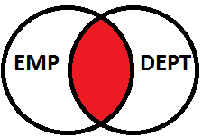
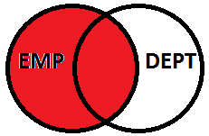
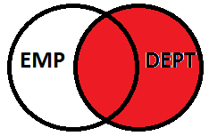
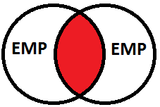
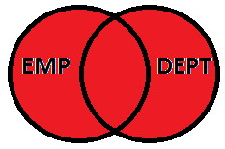
Types of Joins continue…
Right Outer Join
Inner Join
Left Outer Join
Full Join
Self Join

Slide 123
SQL Inner Join (Equi Join)
Show the employees with their department name who are associated with any department.
SELECT ename, dname
FROM EMP JOIN DEPT
ON dept.dept_code = emp.dept_code;

Slide 124
Outer Join
Right Outer Join: Show the employees with their department name who are associated with any department along with departments with no employees associated.
SELECT a.empno, a.deptno, b.dname
FROM emp a RIGHT OUTER JOIN dept b
ON (a.deptno=b.deptno);
Left Outer Join: Show the employees with their department name whether or not they are associated with any department.
SELECT a.empno, a.deptno, b.dname
FROM emp a LEFT OUTER JOIN dept b
ON (a.deptno=b.deptno);

Slide 125
Outer Join continue…
Full Outer Join: Show the employees with their department name irrespective whether employees associated with departments or departments associated with employees.
SELECT a.empno, a.deptno, b.dname
FROM emp a FULL OUTER JOIN dept b
ON (a.deptno=b.deptno);

Slide 126
Self Join
Show the employees with their manager’s name.
SELECT employee.ename, manager.ename
FROM emp employee join emp manager
on emloyee.mgr = manager.empno;

Slide 127
SUBQUERIES
Subquery is a query within a query.
Subquery can be nested inside SELECT, INSERT, UPDATE, or DELETE statements.
Subqueries must be enclosed within parentheses.
There are three types of subqueries:
Single Row Sub Query
Multiple Row Sub Query
Correlated Sub Query

Slide 128
Subquery Types
Single Row Sub Query
Single row subquery always returns a single row with single column only.
SELECT order_name order_price FROM Orders where order_price = (SELECT MAX(order_price) FROM Orders)
Multiple Row Sub Query
Multiple row sub query returns more than one row. Hence it is generally handled using IN comparison operator.
SELECT order_name order_price FROM Orders where item_id IN (SELECT itemId FROM Items where item_price > 1000)

Slide 129
Subquery Types
Correlated Sub Query
In correlated subquery the inner query depends on values provided by the outer query.
SELECT EMPLOYEE_ID, salary, department_id
FROM EMP E
WHERE salary > (SELECT AVG(salary)
FROM EMP T
WHERE E.department_id = T.department_id)

Slide 130
SUBQUERIES
SELECT * FROM orders
WHERE cust_code IN (
SELECT cust_code FROM customer
WHERE city_code = 'PUNE‘ );
SELECT * FROM dept
WHERE EXISTS (
SELECT * FROM emp
WHERE emp.deptno = dept.deptno);
SELECT * FROM dept
WHERE NOT EXISTS (
SELECT * FROM employee
WHERE employee.dept_code = dept.dept_code);

Slide 131
Thank You For Participating
CONTACT
PHONE:
+91 9930 777 883
LinkedIn
https://tinyurl.com/onkarProfile
EMAIL:
onkar.java@gmail.com

